Slide 1
Your Disability Accommodations at MSU: IEPs, 504s, and More! Resource Center for Persons with Disabilities (RCPD) https://www.rcpd.msu.edu/
Notes:
Hello and welcome to MSU! Today I will be briefly telling you about the Resource Center for Persons with Disabilities. In this presentation we will discuss how to access accommodations and supports if you have a disability, medical condition, and/or diagnosed mental health condition. A copy of this presentation is available for download on our website on our Future Students page.

Slide 2
Who are we?
RCPD facilitates accommodations for MSU students and employees. We also offer programming, scholarships, 1-on-1 support, and more!
RCPD’s website: https://www.rcpd.msu.edu.
Individualized Services: Every RCPD advisor, called an Access Specialist, has an area of expertise. Each student is assigned a specialist who is familiar with their diagnosis(es), common accommodations, and relevant resources.
Contact Information for each RCPD staff member and our office can be found on our Team RCPD page.
Notes:
RCPD strives to make our campus accessible, equitable, and inclusive. You can familiarize yourself with our office on our website, rcpd.msu.edu. Every RCPD advisor, called an Access Specialist, has an area of expertise, so each student is assigned a specialist who is familiar with their diagnosis, common accommodations, and relevant resources.
To contact us, visit our Team RCPD page.

Slide 3
Registering with RCPD https://www.rcpd.msu.edu/get-started
**Disability status does NOT automatically follow you to college!**
Self-identify through RCPD’s MyProfile: https://myprofile.rcpd.msu.edu
Sign in with your MSU NetID and password
Click “Request to Meet a Specialist” under “Student Options” on the left side of the page
Fill the form, choosing your disability category. If you don’t know which category to choose, read more on our website.
After submitting, you will receive an autoreply email from your assigned RCPD specialist with reminders about next steps.
Notes:
Disability status does not automatically follow you from high school or from a different higher education institution to MSU. If you need to request accommodations, you must register with RCPD through the following steps. All steps are explained on our get started page linked at the top of this slide.
The first step is to self-identify through RCPD’s MyProfile site. After submitting, you will receive an autoreply email from your Specialist.

Slide 4
Registering with RCPD, cont., 1 https://www.rcpd.msu.edu/get-started
Submit disability documentation to your assigned specialist
You can respond to the email you receive with your documentation attached, send to RCPD.Docs@msu.edu, drop off at RCPD, or send via mail or fax.
If you are assigned more than one specialist, we will consolidate your case to one person after receiving documentation.
Find our office contact information on our Team RCPD page.
Your specialist’s email address can be found via the automatic reply you receive from MyProfile, by searching their name in the search bar at www.msu.edu, or by calling the RCPD front desk (517-884-7273).
Notes:
The second step is to submit disability documentation. Visit the “documentation” link on this slide for guidelines and instructions for submission. If you self-identify with more than one diagnosis, you may be initially connected with multiple specialists. If this happens, we will consolidate your case to one person. Remember, don’t send disability documentation to any office besides RCPD.

Slide 5
Registering with RCPD, cont., 2 https://www.rcpd.msu.edu/get-started
Schedule a needs assessment meeting with your specialist to discuss and determine accommodations
Your specialist will review your documentation and send you their personal Microsoft Bookings link to schedule your needs assessment.
This meeting can be in person, over the phone, or via video chat.
Do not wait until you get to campus to have this meeting! Students are encouraged to begin registration at least 60 days in advance of arriving to MSU. *You can register anytime during your time at MSU, but accommodations cannot be implemented until this process is complete.
Receive your Accommodation Letter to share with instructors
Notes:
After your specialist receives and reviews your documentation, they will email you to schedule a needs assessment meeting where accommodations are determined. You will then receive your accommodation letter and you will be responsible for sharing this with your instructors.
Know that your information is kept confidential. We recommend students begin registration at least 60 days in advance of their first semester, so there is time to complete the process before classes begin. Students can register with RCPD any time during their time at MSU, but this process must be completed before accommodations can be implemented.

Slide 6
Steps for Implementing Your Accommodations https://www.rcpd.msu.edu/get-started/student-accommodations
When classes start, email your Accommodation Letter to each of your instructors. Make sure to let your instructor know which course and section you are in.
Have a conversation with each instructor during office hours to discuss which accommodations you will need for their class and how they will be implemented.
Follow up with your instructors via email or during office hours when needed to implement rarely used accommodations or to remind them that you will need an accommodation soon (for example: on an upcoming test)
Notes:
Okay, you have your Accommodation Letter! However, RCPD will be the only office on campus that knows you need for accommodations. You are responsible for communicating with your instructors to ensure your accommodations are implemented in each class. This slide has a few steps for communicating your accommodations with your instructors.
On our website, we have video examples for this conversation and plenty of reminders for sharing your letter!

Slide 7
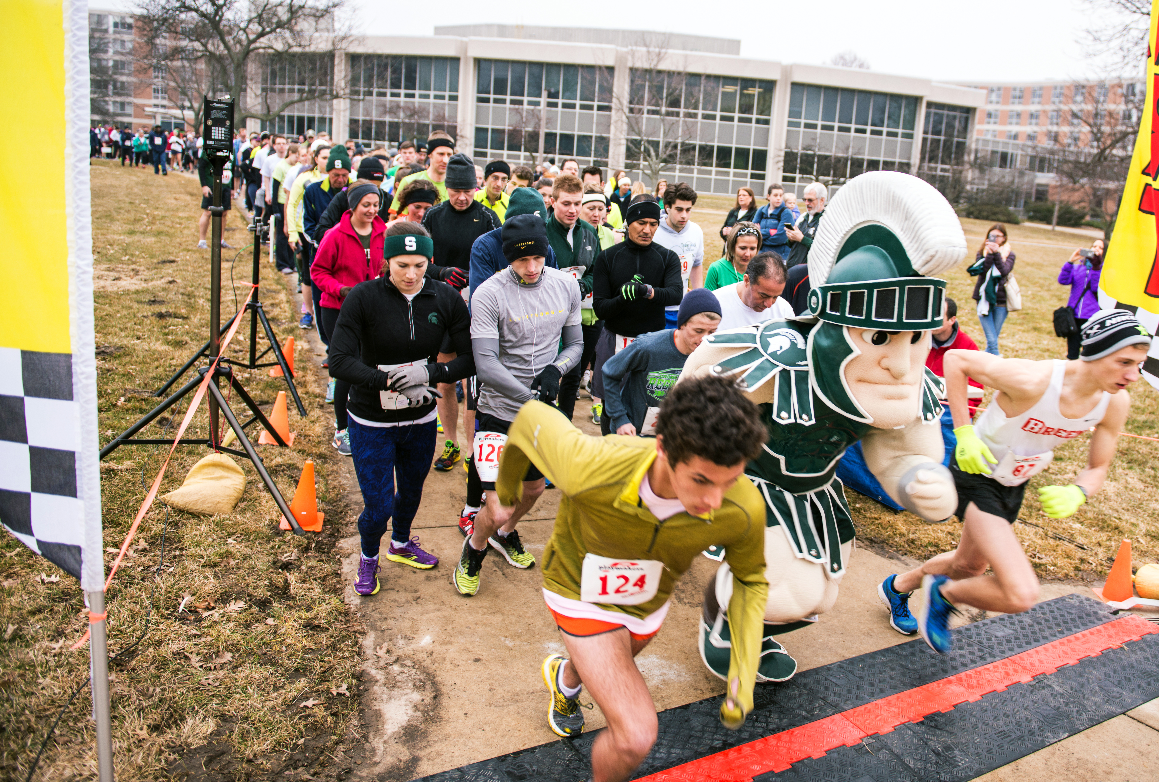
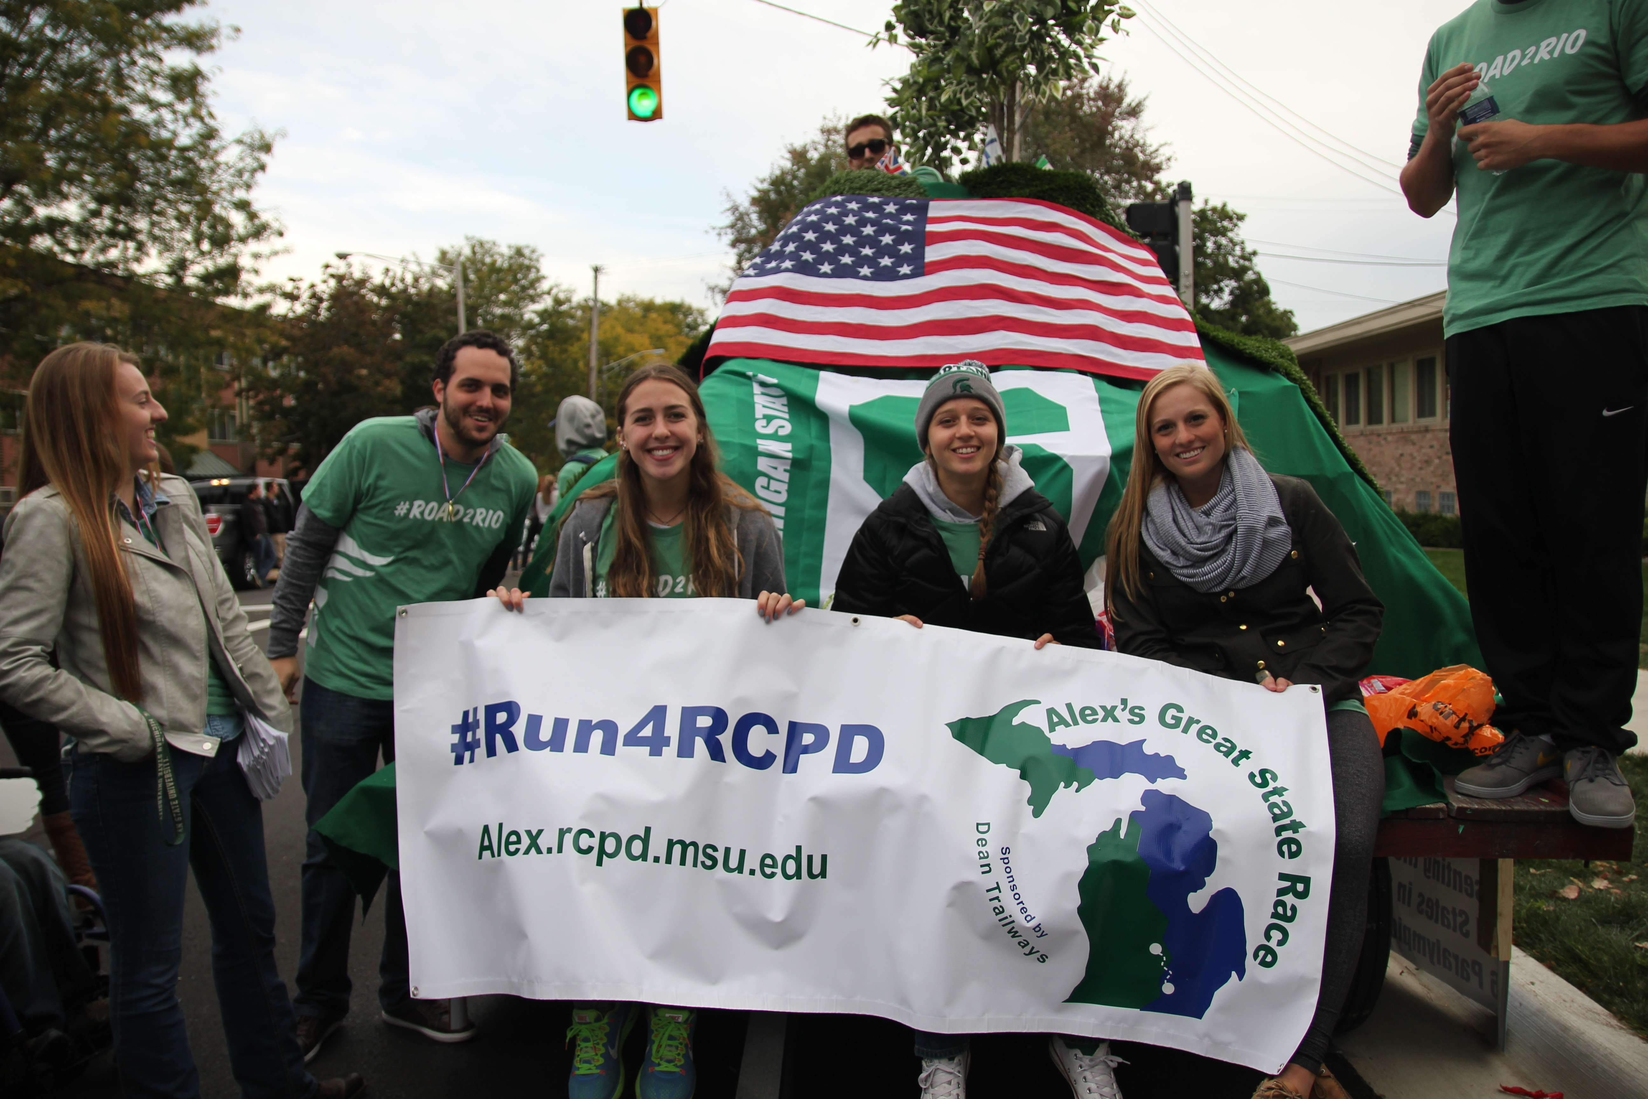
RCPD Resources
Signature Programming: RCPD offers programming to help students succeed and have some fun at MSU. Check out our website for more information!
We teach two first-year seminar classes: UGS 110, focused on getting students acclimated to MSU. One section invites all students, and one is specifically for our autistic students.
Scholarships: RCPD also awards scholarships each year! Recipients are honored at our annual Awards and Appreciation Reception.
Directions to RCPD
Notes:
Finally, there are many additional resources RCPD has to offer, including programming, classes, scholarships, and more.

Slide 8
Contacting RCPD
If you have questions, you are welcome to…
Call the RCPD front desk by email or phone: 517-884-7273
Contact an Access Specialist by visiting our Team RCPD page
Check our Future Students page (https://www.rcpd.msu.edu/get-started/future-students) for additional information including a copy of these slides and the differences between high school and college.
Notes:
Please contact us if you have questions! And be sure to download a copy of presentation from our Future Students page so you can review this info plus additional FAQs! Go Green!

Slide 9
RCPD Specialist FAQs
What role does my specialist play after the needs assessment?
RCPD specialists are available by phone, email, and scheduled appointment (in person & video!). We can assist in communication with instructors, implementing accommodations, helping you strategically stay on track with coursework, discovering new strategies and resources, and more.
Can my RCPD specialist help me choose classes, make a schedule, and enroll?
RCPD specialists do not have expertise in courses or major requirements. The best resource for scheduling classes, changing majors, and exploring major requirements is your academic advisor in your college. If you need help finding your academic advisor or scheduling an appointment, you can ask your RCPD specialist!

Slide 10
RCPD Specialist FAQs, continued
Can an RCPD specialist prescribe medication, provide therapy, evaluate my disability diagnoses, etc.?
RCPD does not perform disability evaluations, provide diagnoses or therapy, prescribe medication, provide auxiliary aids (wheelchairs, etc.), nor approve barrier-free parking passes (State of MI disability parking placard), but we can help refer you to appropriate campus and community resources! Don’t hesitate to ask your RCPD specialist for information about these services.

Slide 11
Accommodation FAQs
Will RCPD send notice to my instructors that I am a registered student with a disability?
No, your instructors will not know you have accommodations until you tell them! Be sure to reference the “Implementing Your Accommodations” slide for steps for sharing your Accommodation Letter with your instructors.
Can I get accommodations if I never officially had them in high school?
Yes! Students can register with RCPD at any time during their career with MSU. Accommodations can only be implemented after the Accommodation Letter is created, so if you think you need accommodations be sure to reach out to RCPD. If you think you have a disability but were never diagnosed, reach out to your doctor, mental health professional, or RCPD.

Slide 12
Documentation FAQs
Will my 504 or IEP be sufficient documentation for MSU?
It depends. If your IEP or 504 is recent and includes a specific diagnosis, detailed information on functional limitations, and demonstrates the need for specific accommodations - the “why” behind accommodations, it will be sufficient.
Where can I get updated documentation?
If you’re unsure about your documentation, don’t delay in registering with RCPD! Your specialist can review your documentation and, if needed, provide resources for updated documentation. Most often, we recommend that your treating medical or mental health professional fill our documentation form found on our Disability Documentation page.

